Slide 1

Salesforce Flow Introduction
Leeds Developer User Group
April 2014

Slide 2

About FinancialForce.com
Strong ties to Salesforce
Joint venture of Salesforce.com and Unit4
Executive involvement
Native on the Salesforce platform
HQ San Francisco; Development teams in US, UK and Spain
260 Employees
Customers in 27 Countries with Users in 45 Countries
3 Force.com MVP’s!
Notes:
FinancialForce ERP is built on a CRM engine and the most flexible cloud platform available today. This allowed us to overcome the limitations of traditional ERP systems to make our applications easier to implement, easy to use and easy to change.
By using this platform, we were able to build the application around a customer’s journey rather than departments or the internal facing approach of the past. This allows us to increase process efficiency and eliminate the walls between department and the barriers between you and your customers.
The result is a system that helps you grow both the top and bottom line.
FinancialForce ERP is the combined effort of two leaders in their field UNIT4 and Salesforce.com. Salesforce is the undisputed leader in online CRM and cloud computing platforms. UNIT4 is a $600 million company that has been building ERP applications for 35 years.
We are truly global company with customers around the world and offices in San Francisco, Toronto, Manchester NH, Harrogate England and Granada Spain.

Slide 3
Session Overview
Understand what Flow is, who uses it, what it can do, where it can be used and future roadmap
What is Flow?
What can I do with it?
Where can it be used?
Empower your Admins with Flow Plugins!
Can I Package it?
Spring’14 and Flow

Slide 4
What is Flow?
Also known as…
Visual Workflow
Visual Flow
#clicksnotcode
What can I do with it?
Create Wizard based UI’s
Manipulate records on Standard or Custom Objects
Callout to Apex code (Advanced)
How is it different from Workflow?
Designed to build UI’s that are process or task orientated
Workflow is event driven based on database events

Slide 5
Where can Flow be used?
URL Entry
Custom Tabs
Custom Buttons
Visualforce Pages
Anywhere a Visualforce page can be used!
Embed in Layouts, Sidebar Component, Salesforce1
Workflow Actions
Pilot for Spring’14, watch this space!

Slide 6
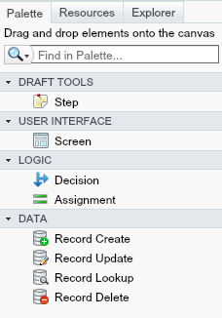
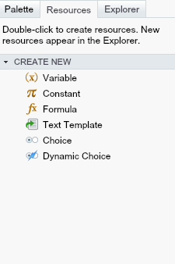
The Flow Toolbox!
Palette and Resources

Slide 7
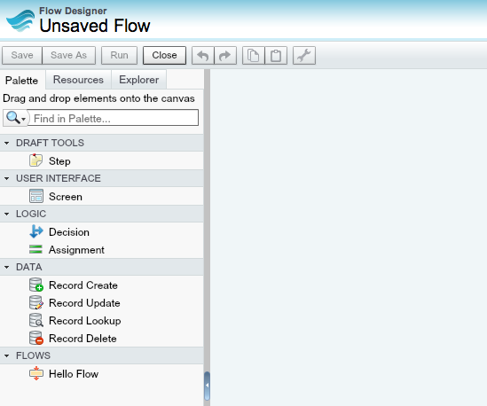
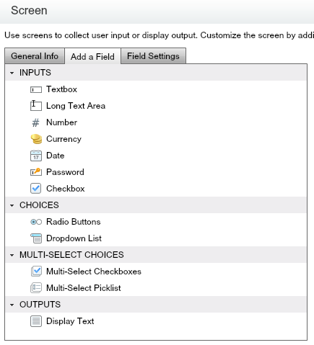
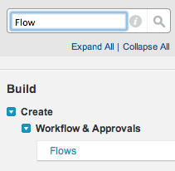

Demo : Basic Flow to Say Hello!
Creating a Flow
Add Screen element
Add Screen output field
Marking the Start element
Running the Flow
/flow/HelloFlow

Slide 8
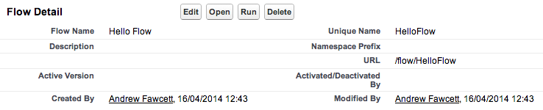
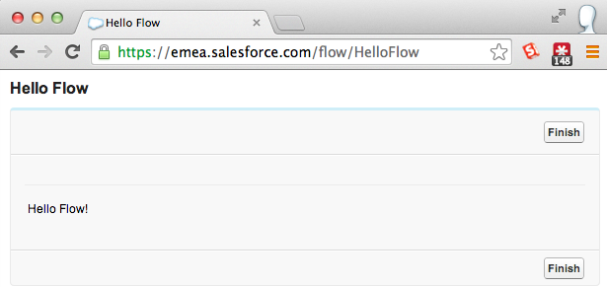
Demo : Basic Flow to Say Hello!

Slide 9
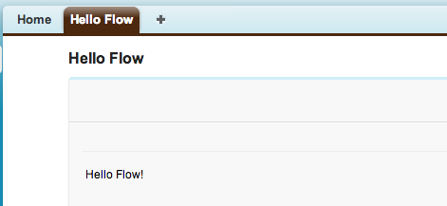
Demo : Connecting to a Tab
Create a Web Tab
Utilize the Flow URL

Slide 10
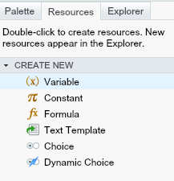
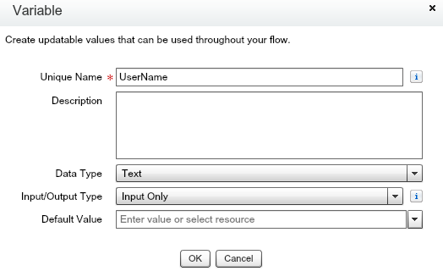
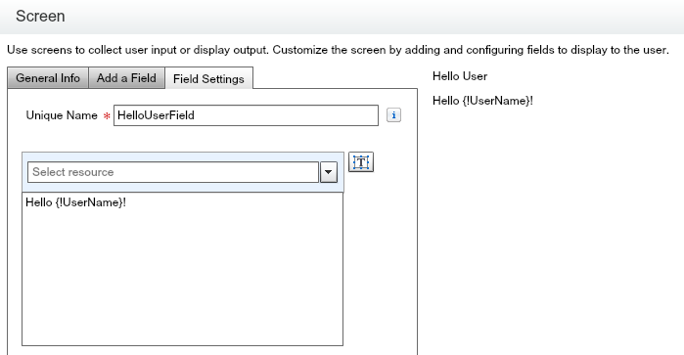
Demo : Passing in Parameters
Create new UserName Variable
Add Screen element referencing the {!UserName} variable
Pass via URL or Visualforce Page

Slide 11
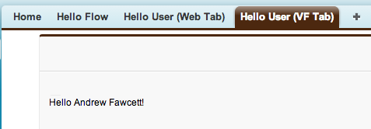

Demo : Passing in Parameters
Passing via URL /flow/HelloUser?UserName=Andrew%20Fawcett
Passing via URL (Web Tab Example)
Passing via Visualforce page (Recommended) (Visualforce Tab Example)
<apex:page >
<flow:interview name="HelloUser">
<apex:param name="UserName" value="{!$User.FirstName} {!$User.LastName}"/>
</flow:interview>
</apex:page>

Slide 12
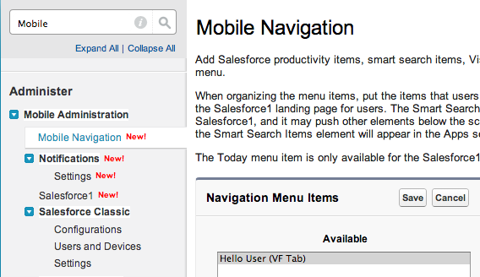
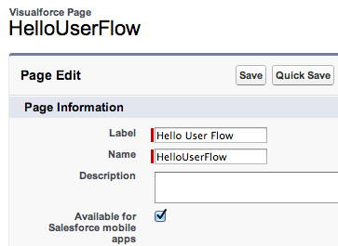
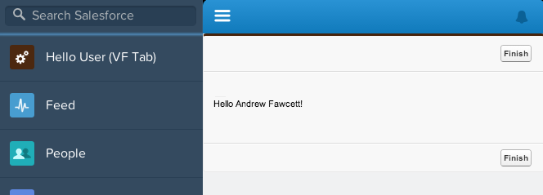
Demo : Flow in Salesforce1

Slide 13
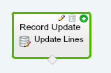
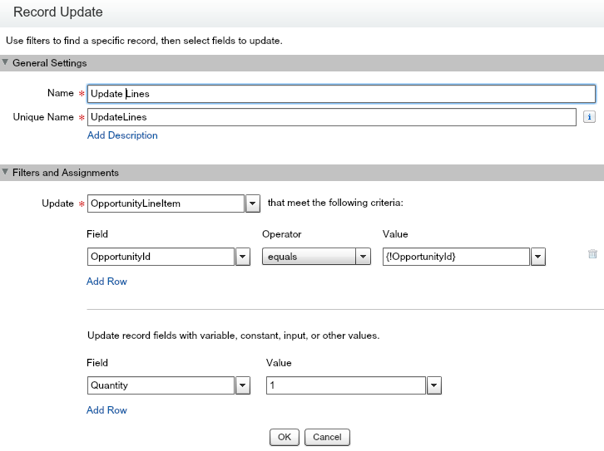
Demo : Updating the Database
Add Variable OpportunityId
Add Record Update element
Reference OpportunityId in filter
Reference fields to update

Slide 14
Demo : Updating the Database
Create Visualforce Page
Using Standard Controller
Create Custom Button
Using above Page
<apex:page standardController="Opportunity">
<flow:interview name="UpdateOpportunityLines” finishLocation="/{!Opportunity.Id}">
<apex:param name="OpportunityId" value="{!Opportunity.Id}"/>
</flow:interview>
</apex:page>

Slide 15

Demo : Creating Sub Flows
“Create a Sub Flow that adds a Opportunity Line Item when given a Product Code, Quantity, Total Price and Opportunity Id”
Add Variables for Input Only
Add Record Lookup element
Looks up the PriceBookEntryId by Product Code
Add Record Create element
Inserts the OpportunityLineItem record
Save the Flow

Slide 16
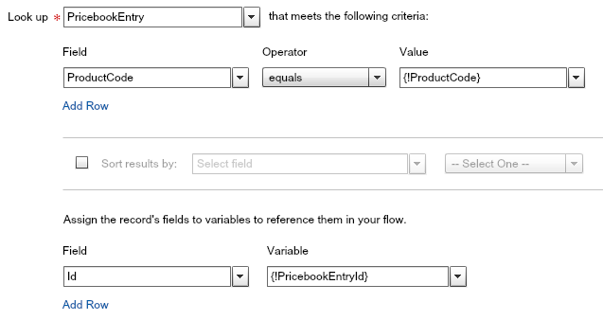
Demo : Creating Sub Flows
Record Lookup element

Slide 17
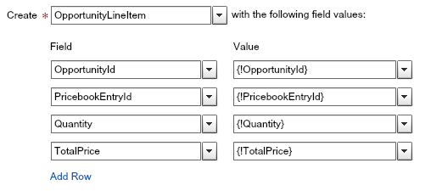
Demo : Creating Sub Flows
Record Create element

Slide 18
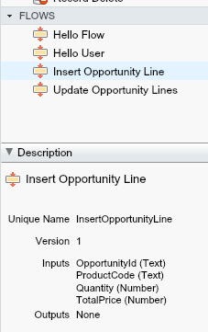

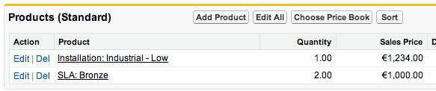
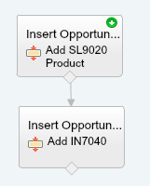
Demo : Inserting Opportunity Lines
Create Variable OpportunityId
Add InsertOpportunityLine elements for each Product required
Create a Visualforce page and Custom Button

Slide 19
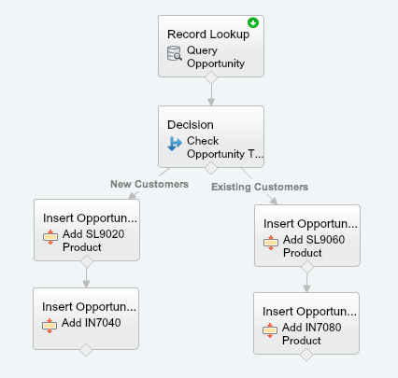
Demo : Conditional Flows
Add Record Lookup element
Query for the Opportunity Type
Add Decision element
Add default Products based on Type

Slide 20
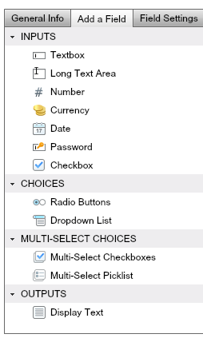
Screen Element “more to see”…
Many UI elements
Radio Buttons
Dropdown Lists
Multi-Selects
Text
Number
Currency
Password
Wizard style decision UI

Slide 21
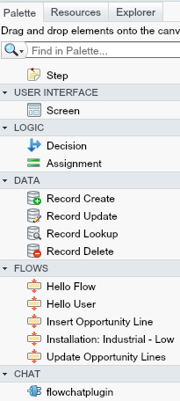
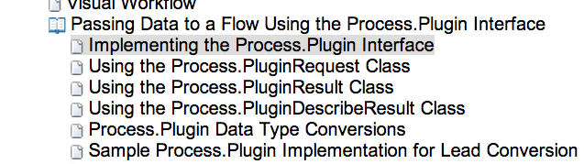
Empower ClicksNotCode with Plugins!
Plugs can extend the Flow Toolbox!
global class MyPlugin implements Process.Plugin {
global Process.PluginResult invoke(Process.PluginRequest request) {
return new Process.PluginResult(result);
}
global Process.PluginDescribeResult describe() {
}
}

Slide 22
Packaging, Change Sets and Metadata API
Packaging
Supported
Upgradable
Subscriber Editable
Only Name, Description and Status
Namespace aware
Change Sets
Supported
Metadata API
Supported
Dynamically create Flows!?! ☺

Slide 23
Spring’14 and “Headless” Flow!
Launch Flows from Workflow Rules—Pilot
“A trigger-ready flow is a flow that can be launched from a flow trigger workflow action. Because trigger-ready flows must be able to run in bulk and without user interaction, they can’t contain Step, Screen, or Apex Plug-in elements in any flow version.”
Create and activate the trigger-ready flow.
Create the workflow rule.
Create the flow trigger workflow action. Make sure you select the same object for the workflow rule and the flow trigger.
Associate the flow trigger to the workflow rule.
Activate the workflow rule.

Slide 24
Spring’14 and “Headless” Flow!
Possibilities!?!
Enhanced Field Defaulting Logic
Default Lookup Fields on Create
Creating Default Related Records
On Create create related records or children
Default Product Lines on an Opportunity?
Calculated Fields
Perform calculations not possible in Formula Fields
Other ideas…?

Slide 25
Spring’14 and “Headless” Flow!
“With great power comes great responsibility!”
Dangers and Limitations
Performance!?!?!
“In a transaction, flow triggers are executed after all workflow field updates, including any Apex triggers and standard validations that are executed as a result of those workflow field updates.”
Hmmm bypass Apex Trigger validations?!?!
Not available on Approval Processes
Not yet available in Change Sets or Packages

Slide 26
Questions?
Contact Info and Social Channels
Twitter: andyinthecloud Blog: andyinthecloud.com
Also on Salesforce StackExchange http://salesforce.stackexchange.com/
GitHub Open Source Projects https://github.com/afawcett https://github.com/financialforcedev

